Slide 1
Physical quantities

Slide 2
Base quantities
Length
Time
Mass

Slide 3
Length
Symbol: l
Unit : 1 meter, 1 m
Other units: 1 mm, 1 cm, 1 dm, 1 km
Other units: 1 yard, 1 inch, 1 mile
Conversion factors

Slide 4
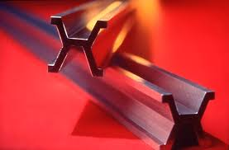
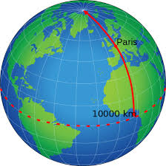
What is 1 meter?
In 1792, in the newborn Republic of France meter was defined
1 m = one ten-millionth of the distance from the north pole to the equator
Standard meter bar in Paris
The distance between two lines engraved on a platinum iridium bar

Slide 5
Time
Symbol: t
Unit: 1 second, 1s
Other units: 1 hour, 1 minute, 1 day
Conversion factor

Slide 6
Mass
Symbol: m
Unit: 1 kilogram, 1 kg
Other units: 1 g, 1 dkg, 1 ton
Other units: 1 oz, 1 lb
Conversion factor

Slide 7
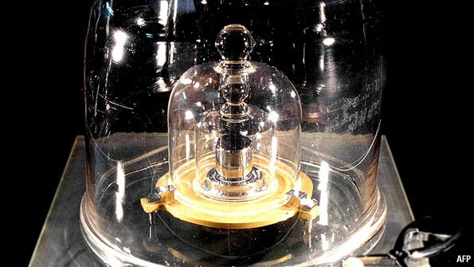
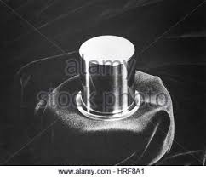
The international 1 kg standard of mass
Platinum-iridium cylinder in Paris

Slide 8
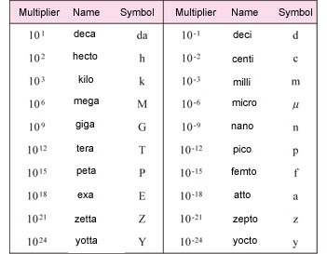
Prefixes for units
Attach a prefix to a unit has the effect of multiplying by the associated factor

Slide 9

Prefixes
kilo, k, ${10}^{3}$
mega, M,${ 10}^{6}$
milli, m, ${10}^{−3}$
micro, $μ$, ${10}^{−6}$
nano, n, ${10}^{−9}$

Slide 10

Scientific notation
Number is written in two parts
$3.2∙{10}^{5}$ =
3.2 $∙$100000=
320000
$4.5∙{10}^{−3}$=
4.5:1000=
0.0045

Slide 11
Derived quantities
Area
Volume

Slide 12

Area
Symbol: A
Unit: $1m^{2}$
Other units: $1 {km}^{2}$, 1${ dm}^{2}$,1${ cm}^{2}$,${1 mm}^{2}$
1 hectare =1 ha =10000 $m^{2}$
Conversion factor

Slide 13

Volume
Symbol: V
Unit: $1m^{3}$
Other units: $1 {km}^{3}$, 1${ dm}^{3}$,1${ cm}^{3}$,${1 mm}^{3}$
Conversion factor
1${ dm}^{3}$=1l, 1${ cm}^{3}$=1ml

Slide 14
Two types of quantities
Scalar quantities
Vector quantities

Slide 15
Scalar quantity
It has only a magnitude
Length
Mass
Time

Slide 16

Vector quantity
It has both a direction and a magnitude
Symbol:$\overline{v,}\overline{F,}\overline{a}$

Slide 17
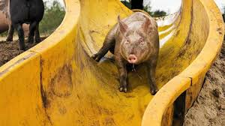
Pointlike object
Every portion of an object moves in the same direction and at the same rate
A pig slipping down a straight playground slide might be considered to be moving like a particle

